Slide 1


TÜRKİYE FİLİPİNLER TİCARİ İLİŞKİLERİ
HALİL ÖZTÜRK
Ticaret Uzmanı

Slide 2

Geography
Capital : Manila
Population : 106.2 million (2018)
Time zone : GMT + 8 hours, single time zone all over the country
: Time difference with Turkey is 5 hours
02

Slide 3
People and Society
Nationality : Filipino
Language : Filipino, English
Religion : Roman Catholic 82.9%
Muslim 5%
Evangelical 2.8%
Iglesia ni Cristo 2.3%
Other Christian 4.5%
Others unspecified 2.5%
02

Slide 4
ECONOMIC FIGURES
GDP : 331 (current prices in US$B, 2018)
GDP Growth Rate : 6,2% (2018)
GDP per capita : 3.104 (current prices US$, 2018)
Inflation rate : 5,2 (2018)
Currency : Philippine Peso (PHP)
Exchange rate : 1 USD = 52,1420 Peso (23 Sept. 2019)
02

Slide 5
02

Slide 6
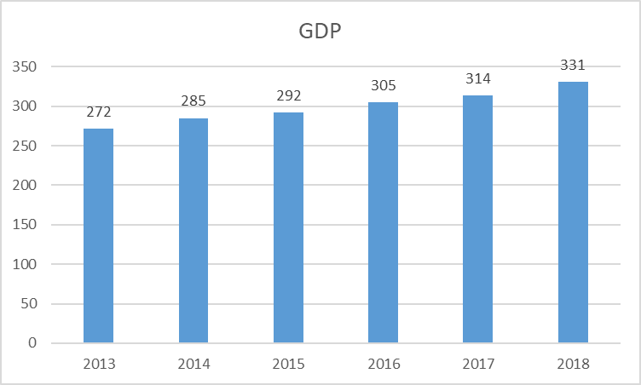
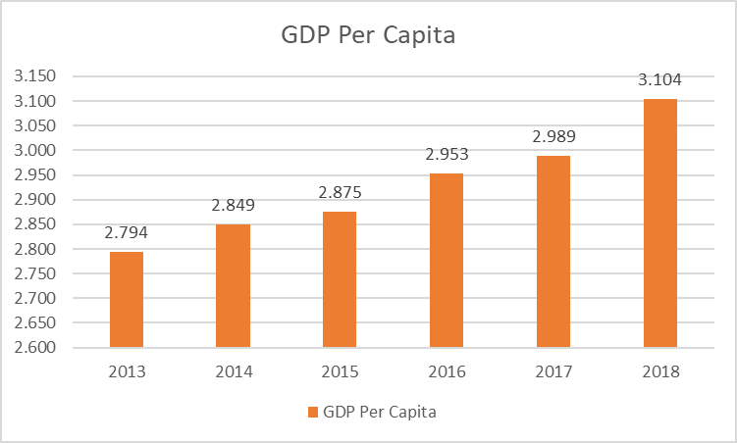
GDP GDP Per Capita
02

Slide 7
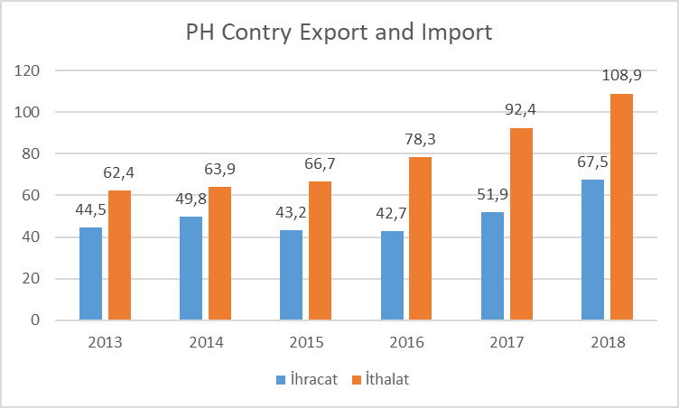
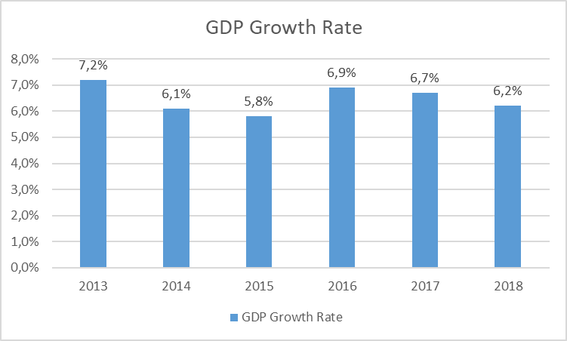
PH Country Import&Export GDP Growth Rate
02

Slide 8


TURKEY and PHILIPPINES
Diplomatic Relations
02

Slide 9
1949 – Treaty of Friendship between Turkey and Philippines was signed
1990 – Turkey established an embassy in Manila
1991 – Philippines established its embassy in Ankara
1995 – State visit of then President Fidel V. Ramos to Turkey
02

Slide 10
2004 – Manila Trade Office was established
2015 – Turkish Airlines began flying directly to Manila in March
– Turkish Development Agency (TIKA) opened its Manila office in April
2018 – First Joint Economic Commission Meeting held in Ankara
02

Slide 11
Agreements Signed
PH-Turkey Trade Agreement (Sign.:1995 Impl.:1996)
Agreement on Economic, Trade and Technical Cooperation (1999)
Bilateral Investment Protection and Promotion Agreement
Agreement for the Avoidance of Double Taxation and Prevention of Fiscal Evasion with Respect to Taxes on Income
Civil Aviation Agreement
02

Slide 12
Cooperation Agreement Between Anadolu Agency (AA) and the Philippines News Agency (PNA)
Agreement on the Cooperation in the Field of Tourism
MoU on Agricultural Cooperation
MoU between Presidency of the Republic of Turkey Investment Office and Board of Investments of the Republic of the Philippines
MoU on Cooperation in Higher Education
MoU on on Cooperation in Defense Industry
02

Slide 13
Agreements for Signature
MoU on Mutual Administrative Assistance in Customs Matters
MoU on SMEs
Maritime Services Agreement
02

Slide 14
PH-TR Trade
02

Slide 15
TR products exported to PH
 |  | 2019 (11 AY)
GTIP Dörtlü Kodu | GTIP Dörtlü Adı | İHRACAT | İTHALAT | HACİM | DENGE
3004 | TEDAVİDE VEYA KORUNMADA KULLANILMAK ÜZERE HAZIRLANAN İLAÇLAR (DOZLANDIRILMIŞ) | 12,722,172 | 679 | 12,722,851 | 12,721,493
9302 | REVOLVERLER VE TABANCALAR ( 93.03 VEYA 93.04 POZİSYONUNDAKİLER HARİÇ) | 11,321,470 |  | 11,321,470 | 11,321,470
1101 | BUĞDAY UNU/MAHLUT UNU | 5,737,299 |  | 5,737,299 | 5,737,299
1902 | MAKARNALAR VE KUSKUS | 4,614,364 | 65,405 | 4,679,769 | 4,548,959
2836 | KARBONAT; PEROKSİKARBONAT; AMONYUM KARBOMAT İÇEREN TİCARİ AMONYUM KARBONAT | 3,451,818 | 155,687 | 3,607,505 | 3,296,131
7113 | MÜCEVHERCİ EŞYASI VE AKSAMI (KIYMETLİ METALLERDEN VEYA KIYMETLİ METALLERLE KAPLAMA METALLERDEN) | 3,445,172 | 2,712 | 3,447,884 | 3,442,460
8504 | ELEKTRİK TRANSFORMATÖRLERİ, STATİK KONVERTÖRLER (ÖRNEĞİN; REDRESÖRLER) VE ENDÜKTÖRLER | 3,159,754 | 2,582,865 | 5,742,619 | 576,889
8702 | 10 VEYA DAHA FAZLA KİŞİ TAŞIMAYA MAHSUS (SÜRÜCÜ DAHİL) MOTORLU TAŞITLAR | 2,318,297 |  | 2,318,297 | 2,318,297
8474 | TOPRAK, TAŞ, METAL CEVHERİ VB. AYIKLAMA, ELEME, TASNİF, AYIRMA, YIKAMA, KIRMA, ÖĞÜTME, YOĞURMA, KALI | 2,301,571 | 1,352 | 2,302,923 | 2,300,219
8429 | BULDOZERLER, GREYDERLER, TOPRAK TESVİYE MAKİNALARI, SKREYPERLER, MEKANİK KÜREYİCİLER, EKSKAVATÖRLER, | 2,256,109 |  | 2,256,109 | 2,256,109
8516 | ELEKTRİKLİ SU ISITICILARI, ELEKTROTERMİK CİHAZLAR, ORTAM ISITICILARI, SAÇ VE EL KURUTUCULARI, ÜTÜLER | 2,252,127 | 587,932 | 2,840,059 | 1,664,195
7409 | BAKIR SACLAR, LEVHALAR, YAPRAKLAR VE ŞERİTLER (KALINLIKLARI 0,15 MM. Yİ GEÇENLER) | 2,140,279 |  | 2,140,279 | 2,140,279
0404 | PEYNİR ALTI SUYU VE TABİİ SÜT BİLEŞENLERİNDEN İBARET DİĞER ÜRÜNLER | 1,824,937 |  | 1,824,937 | 1,824,937
2401 | YAPRAK TÜTÜN VE TÜTÜN DÖKÜNTÜLERİ | 1,720,714 | 628,037 | 2,348,751 | 1,092,677
02

Slide 16
TR products exported to PH Cont.
 |  | 2019 (11 AY)
GTIP Dörtlü Kodu | GTIP Dörtlü Adı | İHRACAT | İTHALAT | HACİM | DENGE
7308 | DEMİR VEYA ÇELİKTEN İNŞAAT VE İNŞAAT AKSAMI, İNŞAATTA KULLANILMAK ÜZERE HAZIRLANMIŞ DEMİR VEYA ÇELİK | 1,652,555 |  | 1,652,555 | 1,652,555
7321 | DEMİR VEYA ÇELİKTEN SOBALAR, MUTFAK SOBA VE OCAKLARI, BARBEKÜ, MANGAL, GAZ OCAKLARI VB İLE BUNLARIN | 1,625,342 |  | 1,625,342 | 1,625,342
5515 | SENTETİK DEVAMSIZ LİFLERDEN DİĞER DOKUNMUŞ MENSUCAT | 1,389,113 |  | 1,389,113 | 1,389,113
3912 | SELÜLOZ VE KİMYASAL TÜREVLERİ (İLK ŞEKİLDE) | 1,326,296 |  | 1,326,296 | 1,326,296
8436 | TARLA VE BAHÇE TARIMINA, ORMANCILIĞA, KÜMES HAYVANCILIĞINA, ARICILIĞA MAHSUS DİĞER MAKİNA VE CİHAZLA | 1,322,945 |  | 1,322,945 | 1,322,945
0207 | KÜMES HAYVANLARININ ETLERİ VE YENİLEN SAKATATI (TAZE, SOĞUTULMUŞ VEYA DONDURULMUŞ) | 1,309,525 |  | 1,309,525 | 1,309,525
0402 | SÜT, KREMA (KONSANTRE EDİLMİŞ, İLAVE ŞEKER VEYA DİĞER TATLANDIRICI MADDE İÇERENLER) | 1,268,680 |  | 1,268,680 | 1,268,680
6109 | TİŞÖRTLER, FANİLALAR, ATLETLER, KAŞKORSELER VE DİĞER İÇ GİYİM EŞYASI (ÖRME VEYA KROŞE) | 1,177,614 | 280,927 | 1,458,541 | 896,687
6006 | DİĞER ÖRME VEYA KROŞE MENSUCAT | 1,152,086 |  | 1,152,086 | 1,152,086
4011 | KAUÇUKTAN YENİ DIŞ LASTİKLER | 1,116,281 | 598,141 | 1,714,422 | 518,140
8451 | DOKUMA İPLİKLERİN, MENSUCATIN YIKANMASI, TEMİZLENMESİ, KURUTULMASI, ÜTÜLENMESİ, SARILMASI, KATLANMAS | 1,038,087 | 155 | 1,038,242 | 1,037,932
02

Slide 17
PH Products exported to TR
 |  | 2019 (11 AY)
GTIP Dörtlü Kodu | GTIP Dörtlü Adı | İHRACAT | İTHALAT | HACİM | DENGE
8542 | ELEKTRONİK ENTEGRE DEVRELER | 4,454 | 26,151,298 | 26,155,752 | -26,146,844
8443 | BASKI YAPMAYA MAHSUS MAKİNALAR; KOPYALAMA VE FAKS MAKİNALARI; BUNLARIN AKSAM, PARÇA VE AKSESUARLARI | 101,177 | 14,462,159 | 14,563,336 | -14,360,982
0801 | HİNDİSTAN CEVİZİ, BREZİLYA VE KAJU CEVİZİ (TAZE/KURUTULMUŞ) |  | 10,254,363 | 10,254,363 | -10,254,363
8471 | OTOMATİK BİLGİ İŞLEM MAK. BUNLARA AİT BİRİMLER; MANYETİK VEYA OPTİK OKUYUCULAR, VERİLERİ KODA DÖNÜŞT | 13,360 | 5,754,021 | 5,767,381 | -5,740,661
5509 | SENTETİK DEVAMSIZ LİFDEN İPLİK (DİKİŞ İPLİĞİ HARİÇ) (TOPTAN) |  | 5,384,644 | 5,384,644 | -5,384,644
8541 | DİYODLAR, TRANSİSTÖRLER VB YARI İLETKEN TERTİBAT; IŞIK YAYAN DİYODLAR (LED); MONTE EDİLMİŞ PİEZO ELE |  | 4,324,406 | 4,324,406 | -4,324,406
8501 | ELEKTRİK MOTORLARI VE JENERATÖRLER [ELEKTRİK ENERJİSİ ÜRETİM (ELEKTROJEN) GRUPLARI HARİÇ] | 103,928 | 3,783,581 | 3,887,509 | -3,679,653
1302 | BİTKİSEL ÖZSU VE HÜLASALAR, PEKTİK MADDELER, PEKTİNATLAR, PEKTATLAR, AGAR-AGAR, BİTKİLERDEN YAPIŞKAN | 153,181 | 3,501,635 | 3,654,816 | -3,348,454
9001 | OPTİK LİFLER, DEMETLERİ, KABLOLARI; POLARİZAN MADDELER; MERCEKLER (KONTAKT LENSLER DAHİL), PRİZMALAR | 9,016 | 3,208,245 | 3,217,261 | -3,199,229
8473 | 84.70 İLA 84.72 POZİSYONLARINDAKİ MAKİNA VE CİHAZLARDA KULLANILMAYA ELVERİŞLİ AKSAM-PARÇA-AKSESUARLA | 5,274 | 2,914,128 | 2,919,402 | -2,908,854
8528 | MONİTÖRLER VE PROJEKTÖRLER, TELEVİZYON ALICI CİHAZLARI | 11,116 | 2,660,773 | 2,671,889 | -2,649,657
02

Slide 18
PH Products exported to TR Cont.
 |  | 2019 (11 AY)
GTIP Dörtlü Kodu | GTIP Dörtlü Adı | İHRACAT | İTHALAT | HACİM | DENGE
8504 | ELEKTRİK TRANSFORMATÖRLERİ, STATİK KONVERTÖRLER (ÖRNEĞİN; REDRESÖRLER) VE ENDÜKTÖRLER | 3,159,754 | 2,582,865 | 5,742,619 | 576,889
4402 | ODUN KÖMÜRÜ |  | 1,798,249 | 1,798,249 | -1,798,249
8523 | SESLERİ VE DİĞER FENOMENLERİ KAYDETMEYE MAHSUS DİSKLER, BANTLAR, KATI HAL KALICI DEPOLAMA AYGITLARI, | 6,875 | 1,586,230 | 1,593,105 | -1,579,355
9102 | KOL SAATLERİ, CEP SAATLERİ VE DİĞER SAATLER (ZAMAN ÖLÇEN SAYAÇLARI DAHİL) (91.01 POZİSYONUNDAKİLER H | 233 | 1,361,087 | 1,361,320 | -1,360,854
4703 | SODALI VEYA SÜLFATLI KİMYASAL ODUN HAMURU |  | 1,352,700 | 1,352,700 | -1,352,700
8536 | GERİLİMİ 1000 VOLTU GEÇMEYEN ELEKTRİK DEVRESİ TEÇHİZATI (ANAHTARLAR, RÖLELER, SİGORTALAR, FİŞLER, KU | 80,697 | 1,329,795 | 1,410,492 | -1,249,098
9104 | MOTORLU KARA TAŞITLAR, UÇAK, UZAY ARACI, GEMİ VEYA DİĞER NAKİL VASITAIARININ ALET TABLOLARINA MAHSUS | 122 | 1,245,347 | 1,245,469 | -1,245,225
8517 | TELEFON CİHAZLARI, SES, GÖRÜNTÜ VEYA DİĞER BİLGİLERİ ALMAYA VEYA VERMEYE MAHSUS DİĞER CİHAZLAR | 1,184 | 1,092,567 | 1,093,751 | -1,091,383
8708 | KARAYOLU TAŞITLARI İÇİN AKSAM, PARÇA VE AKSESUARLAR | 278,637 | 1,009,699 | 1,288,336 | -731,062
8419 | ISI DEĞİŞİKLİĞİ YÖNTEMİ İLE MADDELERİ İŞLEMEK İÇİN CİHAZLAR, ELEKTRİKLİ OLMAYAN ŞOFBENLER VEYA DEPOL | 507,748 | 965,015 | 1,472,763 | -457,267
8529 | SADECE VEYA ESAS İTİBARİYLE 85.25 İLA 85.28 POZİSYONLARINDA YER ALAN CİHAZLARA MAHSUS AKSAM VE PARÇA | 1,083 | 859,188 | 860,271 | -858,105
4010 | VULKANİZE KAUÇUKTAN TAŞIYICI KOLANLAR VE TRANSMİSYON KOLANLARI | 82,596 | 830,832 | 913,428 | -748,236
02

Slide 19
Potential export products of TR to PH
Food (e.g. wheat flour, pasta, olive oil)
Pharmaceutical
Motor vehicle
Construction materials
Textile
Home textile
Poultry
Fabric
Plastic products
Chemicals
Glass
Electrical machinery
Firearms and ammunitions
Fresh Fruits and Vegetables
02

Slide 20
Issues (Investment and Trade) 1
% 40- 60 Rule in Wholesale Business (Exception 200.000 USD)
No Foreing Share in Retail Business
Contractors
  Quadruple A (AAAA) License for %100 Foreign Ownership
  1 billion Filipino Peso (Approx. 20 million USD) investment requirement
  Other Categories min. %60 local partnership
  Philippine Contractors Accreditation Board (PCAB)
  MoU between Philippine Overseas Construction Board (POCB) ile Türkiye Müteahhitler Birliği (TMB), April 2019
02

Slide 21
Issues (Investment and Trade) 2
For Public Procurement
  https://www.philgeps.gov.ph/
For Big Investment Projects
  https://ppp.gov.ph/list-of-projects/
  http://www.build.gov.ph
For Tariffs
  http://finder.tariffcommission.gov.ph/index.php?page=tariff-finder3
Economic Zones
  http://www.peza.gov.ph/
Board of Investments
  http://boi.gov.ph/
02

Slide 22
Issues (Investment and Trade) 3
Approved Projects for Procurement:
  PEZA Electronic Payment Solution
Projects Under Review by Implementing Agencies:
  Davao Sea Port Modernization Project
  Development, Operations and Maintenance of General Santos Port
Projects under Procurement:
  Bulacan International Airport Project (New Manila International Airport)
  Road Transport Information Technology (IT) Infrastructure Project (Phase II)
  Pasay City Reclamation Project
02

Slide 23
Issues (Investment and Trade) 4
For Approval of Relevant Government bodies:
  Davao International Airport Development, Operation, and Management
  O&M and Facility Upgrade of Kalibo International Airport
  MRT-11 Project
  Upgrade, Expansion,Operations and Maintenance of Laguindingan Airport
  50 year Integrated Development Plan for Mactan Cebu International Airport (MCIA) Project
  Philippine Charity Sweepstakes Office (PCSO) Corporate Center
  East-West Rail Project
  C5 MRT 10 Project
  Cavite LRT Line 6c and Sucat Line 6b Projects
  Preservation and Development of Laguna de Bay Project
  Manila Bay Integrated Flood Control, Coastal Defense and Expressway Project
  Fort Bonifacio – Makati Skytrain Project
  San Ramon Newport Project
  Davao People Mover
  Cavite-Tagaytay-Batangas Expressway Project
  LRT 6 Cavite Line A
  Upgrade, Expansion, Operations and Maintenance of the New Bohol International Airport (Panglao)
  Ninoy Aquino International Airport
02

Slide 24
Issues (Investment and Trade) 5
Projects under Development:
  Angat Hydroelectric Power Plant (AHEPP) Project Rehabilitation, Operation and Maintenance of Auxiliary #4 and #5
  Central Luzon Link Expressway (CLLEX) Phase 1 O&M and Phase 2
  Cebu Bus Rapid Transit (BRT) Operations and Maintenance Project
  Cagayan Valley Medical Center Hemodialysis Unit
  CCP Asset Development Project
  Duty Free Philippines Retail Development Project
  PGH Cancer Center
  Philippine General Hospital (PGH) Diliman O&M PPP Project
  NDC Admin and Commercial Complex (formerly One DTI Building Complex) Project
02

Slide 25
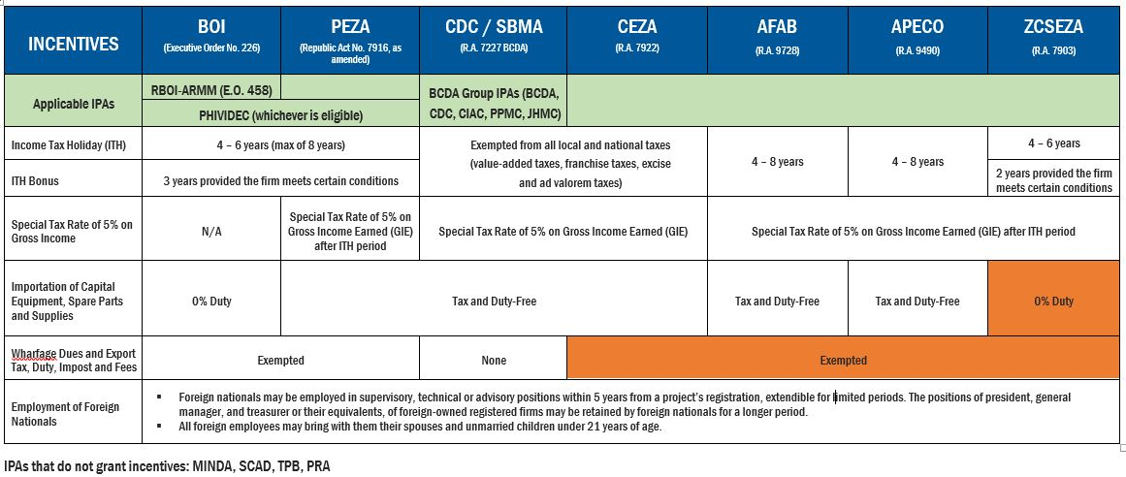
Issues (Investment and Trade) 7
CDC-SBMA= Clark Development Authority, Subic Bay Metropoliton Authority
CEZA= Cagayan Economiz Zone Authority AFAB= Authority of the Freeport Area of Bataan
APECO= Aurora Pacific Economic Zone and Freeport ZCSEZA= Zamboanga City Special Economic Zone
IPA= Investment Promotion Authority Authority & Freeport
02

Slide 26
Related Government Agencies
Board of Investments (BOI)
Atty. Raul V. Angeles
Executive Director – Investment Assistance Center
Telefax: 897-3079
Investment Assistance Center (IAC)
Ground Floor Industry and Investments Bldg
385 Sen. Gil Puyat Ave., Makati City
Tel no.: 895.36.40 / 895.36.41 / 895.36.57
Direct line. 895.83.22
Email: bossac@boi.gov.ph
Web: www.boi.gov.ph
Lanie O. Dormiendo
Chief - Europe, Middle East & Africa Division
International Investments Promotion Service
Board of Investments
385 Sen Gil Puyat Ave., Makati City
DL: (632) 897-3083
TL: (632) 895-3521 loc 214
Fax: (632) 895-3521
Philippine Chamber of Commerce and Industry (PCCI)
Ms. Bing Sibal-LIMJOCO
Chairman
E-mail: gtbmnl@gmail.com
Dr. Francis CHUA
Chairman Emeritus
Chairman of International & Trade Affairs
3F Commerce and Industry Plaza,1030 Campus Avenue
Cor. Park Ave. McKinley Town Center, Fort Bonifacio, Taguig City
Tel.no.: 864 8196
Fax no.: 846 8619
E-mail: francis@info.com.ph
Philippine Economic Zone Authority (PEZA)
Ms. Charito PLAZA
Director – General
Tel. No: 551-3454
Fax No: 891-6380
Email: odg@peza.gov.ph
Address: Roxas Boulevard corner San Luis Street, Pasay City
Mr. Elmer H. San Pascual
Group Manager
Promotions and Public Relations Group
Tel. No: 551-3438
Fax No: 551-3436
Email: info@peza.gov.ph
Web : www.peza.gov.ph
02

Slide 27
TÜRKİYE-FİLİPİNLER İŞ KONSEYİ
ÜLKEMİZDE YERLEŞİK FİLİPİNLER DERNEK VE KURULUŞU
Dernek Adı : TÜRK-FİLİPİNLER İŞ KONSEYİ
İletişim : İlkem ŞAHİN
Ünvan : Başkan
Adres : Dış Ekonomik İlişkiler Kurulu (DEİK)
TOBB Plaza, Talatpaşa Caddesi, No: 3 Kat: 5
34394 Levent, İstanbul, Türkiye
Tel No. : (90 212) 3395000
Fax No. : (90 212) 2703784
E-mail : info@deik.org.tr
Website : http://www.deik.org.tr
FİLİPİNLER’DEKİ YERLEŞİK TÜRK DERNEK VE KURULUŞU
Dernek Adı : FİLİPİNLER-TÜRK İŞ KONSEYİ
İletişim : Ernesto N.Chua C.K.
Ünvan : Başkan
Adres : Philippine Chamber of Commerce and Industry
3rd Floor, Commerce and Industry Plaza,
1030 Campus Ave.cor Park Ave., Mckinley Town Center
Fort Bonifacio, Taguig City, Philippines
Tel No. : (63 2) 8468196 loc. 131
Fax No. : (63 2) 8468619
Gsm No. : (63 918) 9189008221
E-mail : mltc-sales@pldtdsl.net
02

Slide 28

TEŞEKKÜRLER
ozturkha@ticaret.gov.tr
manila@ticaret.gov.tr
02

